Slide 1
I B.Sc (SEMESTER-I)
GASEOUS STATE
PART-I
PRESENTED
BY
RAMBABU VASAMSETTI
LECTURER IN CHEMISTRY
P.R.GOVERNMENT COLLEGE(A)
KAKINADA

Slide 2
Introduction
A substance can exist in three physical states
Gas
Liquid
Solid

Slide 3
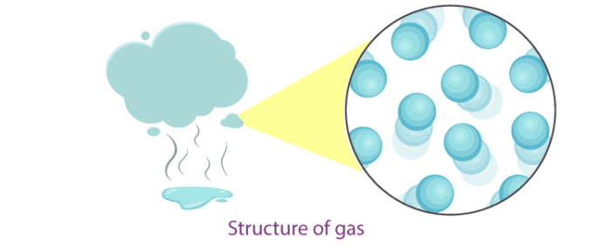
Gases
In gases, particles are far apart from each other.
Force of attraction between the particles is negligible, and they can move freely.
Gases have neither a fixed volume nor a fixed shape.
The gaseous state has the highest compressibility as compared to solids and liquids.
The rate is diffusion is higher than solids and liquids.
The kinetic energy of particles is higher than in solids and liquids.
An example of gases: air, helium, nitrogen, oxygen, carbon dioxide, etc.

Slide 4
Gas laws

Slide 5
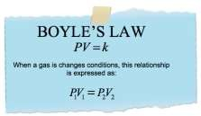
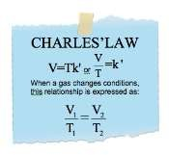
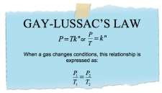
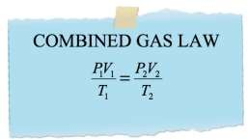
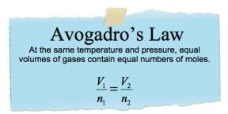
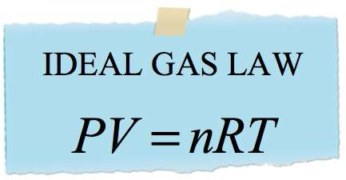

Slide 6
Ideal gas and non-ideal gas
Ideal gas:
A gas which obeys the three gas laws under all conditions of temperatures and pressures is known as an ideal gas or a perfect gas. It is observed that there is no gas which obeys the gas laws or the ideal gas equation under all conditions of temperatures and pressures. However gases obey these gas laws fairly well at low pressures and high temperatures.
Non-ideal gas or real gas:
A non-ideal gas or real gas is the one which obeys the gas laws only under low pressures and high temperatures. All gases are non-ideal gases or real gases only. They show deviations from ideal behaviour when the pressures are too high and temperatures are too low

Slide 7
DEVIATION FROM IDEAL BEHAVIOUR
Deviations from Boyle’s Law (Effect of Pressure Variation on Deviations)
From the figure we can observe that at constant temperature PV vs P curve for a real gas is not a straight line parallel to Pressure axis.
In the curves for H2, He as the pressure increases the value of PV also increases.
For the gases like CO and CH4 the PV value decreases with increase in pressure and reaches to a minimum value and then increases with pressure. Thus, real gases do not follow the ideal gas equation perfectly under all conditions of pressure.

Slide 8
Deviation from Charles’ Law
(Effect of Temperature on Deviations)
According to Charles’ law, the coefficient of expansion of volume of every gas should be same i.e., 1/273 of its volume at OºC at all pressures. However, in practice this is found to be so only at low pressures and considerable deviation sets in with the increase in pressure.

Slide 9
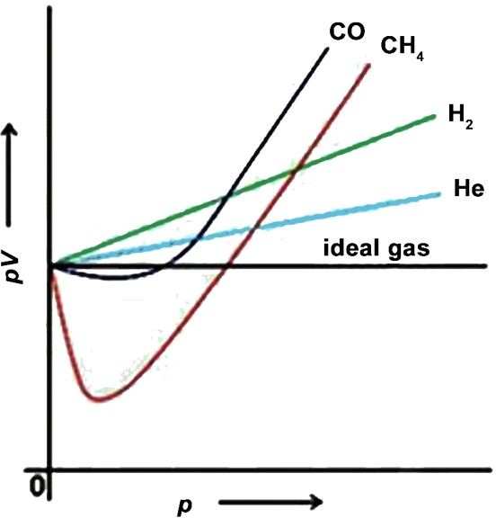

Slide 10
Compressibility factor (Z)
The compressibility factor is also called compression factor.
This factor describes the deviation of a real gas from the ideal behaviour. It is denoted by ‘Z’.
It is defined as the ratio of molar volume of a gas to the molar volume of an ideal gas at the same temperature and pressure.
It is a useful thermodynamic property for modifying the ideal gas law to account for the real gas behaviour.

Slide 13
Deviation of real gas from ideal behaviour
Real gases show deviations from ideal behaviour only under the conditions of high pressures and low temperatures. These deviations are due to two faulty assumptions that are made in the kinetic molecular theory of gases. They are
The volume occupied by the gas molecules is highly negligible as compared to the total volume of the gas
The forces of attraction or repulsion among the gas molecules are negligible.
The above two assumptions are true only if the pressure is low or the temperature is high so that the distance between the molecules is sufficiently large. However, if the pressure is high or the temperature is low, the gas molecules come closer together. Under these conditions:
The forces of attraction or repulsion between the molecules are to be considered.
The volume of the gas is so small that the volume occupied by the gas molecules cannot be neglected.

Slide 14
van der Waals equation of state
van der Waals equation is particularly used to understand the behaviour of real gases.
This gives a simple physical picture for the difference between a real gas and an ideal gas.
van der Waals obtained the equation for real gases by applying the corrections for volume and pressure as follows.
Correction for the volume:
Suppose v is the actual volume occupied by one mole of the gas molecules. Since the gas molecules are in motion, it has been found that the effective volume occupied by the gas molecules is four times the actual volume (4v). Let it be represented by “b”.
The volume b is called co-volume or excluded volume.
Thus, the free space available for the movement of gas molecules is
(V-b).
Hence in the ideal gas equation V should be replaced by (V-b).

Slide 15
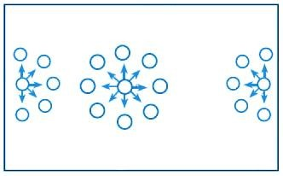
Correction for the force of attraction- pressure correction
A gas molecule present in the interior of the gas, say molecule A in figure is attracted equally by all other gas molecules surrounding it.
Hence the net force of attraction exerted on such a molecule by the other molecules is zero.
However, for a molecule lying near the wall of the container, say molecule B in figure the molecules lying inside the bulk of the gas exert some net inward pull.
Molecule A Molecule B

Slide 16
Thus, the effect of such inward pull is ‘dragging back’ of the molecule. Consequently the pressure with which the gas molecule strikes the wall of the vessel is less than the pressure that would have been exerted if there were no such inward pull.
Thus, the ideal pressure would be greater than the observed pressure by a factor ‘p’.
Corrected pressure = P + p
Where, p is the correction factor due to the inward pull.
This inward pull on the gas molecules present near the wall depends upon:
Number of molecules surrounding the molecule,
Total number of molecules.
Each of these factors in turn depends upon the density (d) of the gas.
Hence correction factor, p α d²
But for a given mass of the gas d = 1/V
p α 1/v²
p = a. 1/v²

Slide 17
Where a is a constant and it depends on the nature of the gas.
Thus the corrected pressure is given by
P = p + a/v²
Substituting the corrected volume and corrected pressure in the ideal gas equation PV = RT for one mole of the gas, the equation is modified to
(P + a/v²)(V-b) = RT .
This equation is known as van der Waals equation.
The constants a and b are called van der Waals constants.
van der Waals equation for “n” moles of a gas is
[P + a(n/v)²][V - nb] = nRT .

Slide 19
Significance of van der Waals Constants
(i) It is observed that the values of ‘a’ for the easily liquefiable gases,
such as SO2, NH3, H2S, CO2 are greater than those for the permanent gases like N2, O2 H2 and He.
Moreover, the value of ‘a’ increases with the ease of liquefaction of the gas. It is observed that a gas which is more easily liquefiable has greater intermolecular forces of attraction.
Hence ‘a’ is a measure of the intermolecular forces of attraction in a gas.
(ii) The ‘b’ is the effective volume of the gas molecules.
The constancy in the value of b for any gas over a wide range of temperature and pressure confirms that the gas molecules are incompressible.

Slide 20
GAS | a (atm L² mol⁻²) | b (L mol⁻¹)
He | 0.034 | 0.0237
H₂ | 0.245 | 0.0266
O₂ | 1.360 | 0.0318
N₂ | 1.390 | 0.0391
CH₄ | 2.250 | 0.0428
CO₂ | 3.592 | 0.0428
NH₃ | 4.170 | 0.0371
Cl₂ | 6.493 | 0.0562
SO₂ | 6.710 | 0.0564

Slide 21
Andrews Isotherms of Carbon Dioxide
The curves representing the variations of volume and pressure at constant temperature are called isotherms (Greek, iso = equal; thermos = warm).
The plot of P vs V at constant Temperature is called an isotherm.
Thomas Andrews was the first to study the effect of pressure on the volume of carbon dioxide at different temperatures.
Andrews measured the volume of carbon dioxide at different pressures, at constant temperature of carbon dioxide.
A number of such isotherms were obtained at different temperatures.

Slide 22
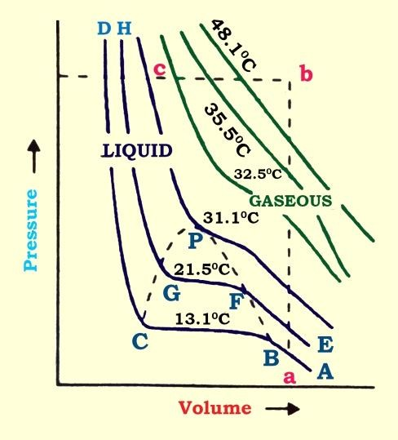

Slide 23
At the temperature of 13.1ºC at low pressure, carbon dioxide exists as a gas as shown at the point A.
As the pressure is increased, the volume of the gas decreases along the curve AB.
At the point B, the liquefaction of the gas starts. Hence the volume decreases rapidly along BC because the liquid has much less volume than the gas.
At the point C, the liquefaction is complete. Now the increase of pressure has very little effect upon the volume because liquids are hardly compressible. Hence a steep curve CD is obtained.
Thus, along the portion AB, carbon dioxide exists only as gas.
Along the portion BC, the liquid and the vapour are in equilibrium with each other.
Along CD, carbon dioxide exists only as liquid.
The isotherm EFGH at 21.5°C is similar to that at 13.1°C except that the horizontal portion over which the liquefaction occurs is shorter. In fact, as the temperature is raised this portion becomes smaller and smaller and finally at 31.1°C, it is reduced only to a point.

Slide 24
Continuity of State
Intermixing of gaseous state into the liquid state and vice versa is known as ‘Continuity of State’.
If the ends of the horizontal portions of the different isotherms are joined together a parabolic curve (shown by dotted lines in Figure) is obtained.
The peak of this parabola represents the critical point. Within the parabola the liquid and the vapour exist together in equilibrium.
Outside the parabola, the substance exists only as a gaseous under the conditions represented on the right side and only as liquid under the conditions represented on the left side.
A careful reveal that below the critical temperature it is possible to change a substance from gaseous state to liquid state without having both the phases present together at any stage.
The change of state from gaseous to liquid state is continuous. Thus it is referred to as the continuity of state.

Slide 25
Critical Phenomena
The term critical phenomenon refers to the peculiar behaviour of a substance when it is at or near the point of a continuous phase transition (critical point).
The specific temperature above which, a gas cannot be converted into liquid whatever high pressure is applied on the gas.
This temperature is called “critical temperature (Tc)” and the temperature above which the gas cannot be converted into liquid even by application of high pressure.
This critical temperature (Tc) and is a characteristic property of a gas.
The minimum pressure required to convert gas into liquid at this critical temperature is called “critical pressure (Pc)”.
The volume occupied by 1 mole of gas at critical temperature (Tc) and critical pressure (Pc) is called “critical volume (Vc)”
Therefore, every gas will have Tc, Pc and Vc.
Example:
CO₂ | 304.3 K | 72.9 atm | 95.65 ml

Slide 26
ధర్మో రక్షతి రక్షితః
సర్వేజనాః సుఖినో భవంతు.

